Slide 1


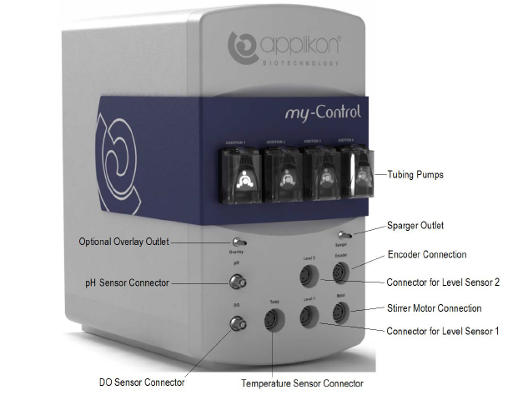

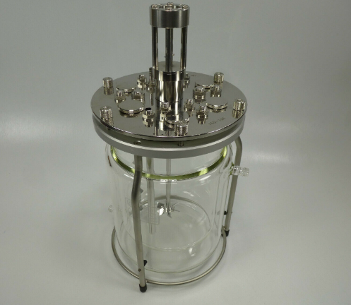
Setpoint Data
OPC Variable Setpoint
Variable
Setpoint
Sensor Data
OPC Server
OPC Client
OPC Sensor Data
OPC Data Logging
Experimental
Setup
My-Control Bio-controller
Sensor Information
Human Machine Interface
Actuator Command
Bio-Reactor

